Slide 1
Module One: Introduction to Service Computing and XML-RPC

Slide 2
Let’s consider an example first
You are a developer for an enterprise Widgets Inc. that sells its products through its web site
Just a basic e-commerce functionality
Customers can purchase parts and check on order status

Slide 3
The current system in the enterprise is not service oriented
Human centric web
Humans are primary actors initiating requests

Slide 4
The Human Centric Web – approach without services
HTTP GET: “What
is the status of
my order?”
Web
Browser
Web
Server
HTTP Response
with HTML Page:
“Leaving the warehouse
at 3 pm today.”
This illustrates a human-centric web, where humans are the primary actors initiating web requests.

Slide 5
Application-Centric Web – service oriented approach
With services, we move from a human-centric web to an application-centric web.
In other words, conversations between applications occur as easily as conversations between web browsers and servers.

Slide 6
The Application-Centric Web
XML Request: “What
is the status of
my order?”
Inventory
Application
Web
Server
On to
human
users
XML Response:
“Leaving the warehouse at 3 pm today.”
On to
other applications
The order status is now a service.
Applications can therefore connect to the order status service directly.

Slide 7
Application-Centric Web
There are numerous areas where an application-centric web would be extremely helpful:
credit card verification
package tracking
shopping bots
single sign-on registration
calendar, email, etc.

Slide 8
What kind of technology support is needed to move from human centric web to application centric web?
What mechanisms do we need?

Slide 9
Here are some ideas
Service discovery mechanisms
A way for the applications that need services to find providers of the services
Service description mechanism
A way for the service clients to know what services providers provide
A way for the providers of the services to describe the services they offer
Common standards
A way for service clients to communicate with service providers
Interoperability support
…

Slide 10
→ Web service are one of the technologies that provide such mechanisms

Slide 11
What is a Web Service?

Slide 12
What is a Web Service?
A Web Service is any service that:
Is available over the Internet or private (intranet) networks
Uses a standardized XML messaging system
Is not tied to any one operating system or programming language

Slide 13
Web services are based on standards
A web service makes software application resources available over networks using standard technologies
Web services standards are the glue that allows computers and devices to interact, forming a greater computing whole that can be accessed from any device on the network

Slide 14
Standardization
The implementation of standards in industry

Slide 15
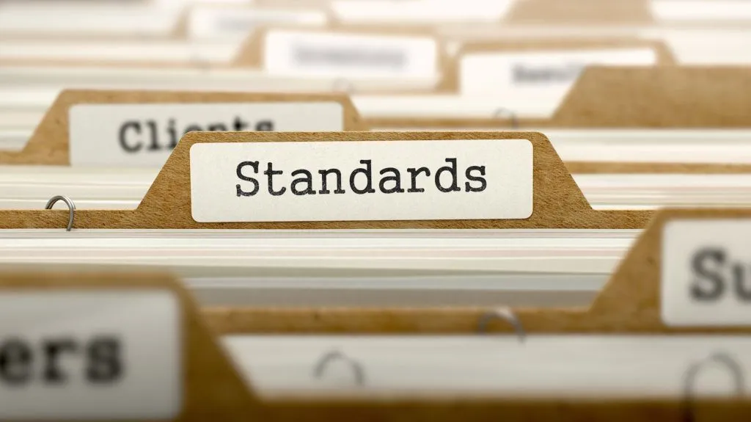
Standardization – definition (1)
The implementation of standards in industry

Slide 16
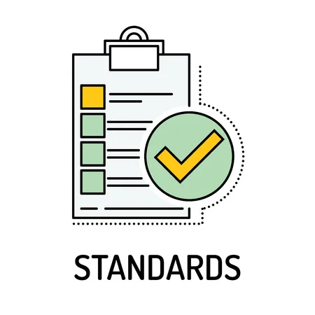
Standard
A standard is a repeatable, harmonised, agreed and documented way of doing something
Standards contain technical specifications or other precise criteria designed to be used consistently as a rule, guideline, or definition

Slide 17
Standard
As defined by ISO (International Standards Organization)
“A standard is a document, established by a consensus of subject matter experts and approved by a recognized body that provides guidance on the design, use or performance of materials, products, processes, services, systems or persons”.

Slide 18
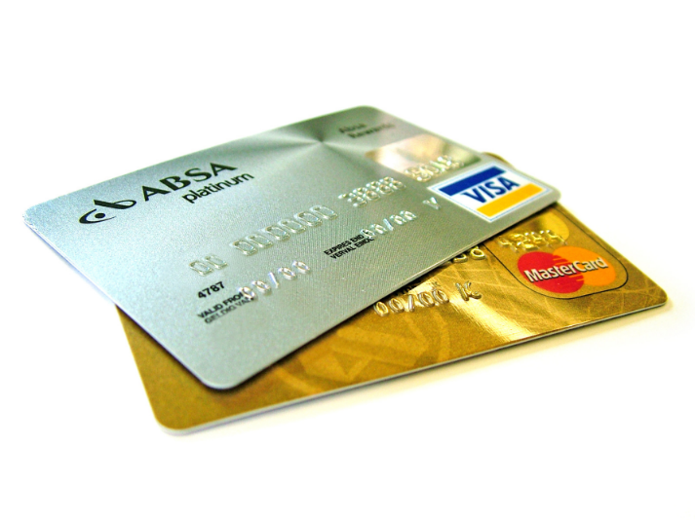
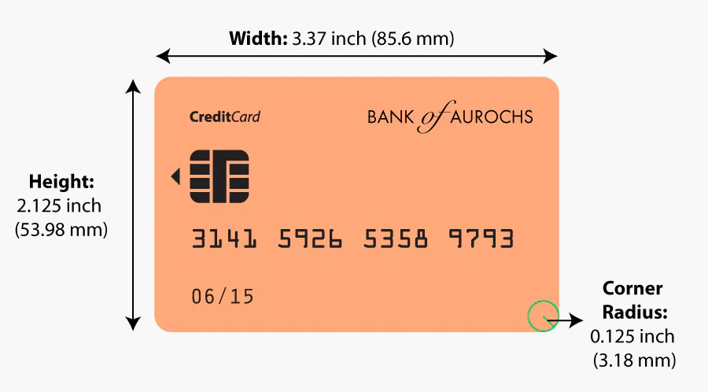
Standard - example
The size of payment cards (ATM cards, credit cards, debit cards, etc.) is 85.60 by 53.98 millimetres and rounded corners with a radius of 2.88–3.48 millimetres
conforming to the ISO/IEC 7810 ID-1 standard “Identification cards — Physical characteristics”

Slide 19
Standardization – definition (2)
The process of creating protocols to guide the creation of goods or services based on the consensus of all the relevant parties in the industry

Slide 20
Standardization purpose (1)
The standards ensure that goods or services produced in a specific industry come with consistent quality and are equivalent to other comparable products or services in the same industry

Slide 21
Standardization purpose (2)
Standardization helps in ensuring the safety, interoperability, and compatibility of goods produced

Slide 22
Industry standardization examples
Parties | Mutual gains | Problem | Solution
Mechanical industry companies | Suppliers interchange, stock gains, etc. | Screw thread compatibility | Screw thread standard specifications
Pharmaceutical industry and medic community | Enable medical prescriptions, suppliers interchange, etc. | Drug uniformity | Drug standard specifications
Banks and specialized payment cards companies | Enable Credit card holder to pay a merchant for goods and services | Credit card uniformity | Credit card technical specifications

Slide 23
Who creates standards
Parties involved in the standardization processes:
Users
Interest groups
Corporations
Industrial or manufacturing associations
Professional societies
Governments
Standards organizations
…

Slide 24
Technical standard
A technical standard is an established norm or requirement for a repeatable technical task which is applied to a common and repeated use of rules, conditions, guidelines or characteristics for products or related processes and production methods, and related management systems practices

Slide 25
Technical standard
A technical standard includes
definition of terms
classification of components
delineation of procedures
specification of dimensions, materials, performance, designs, or operations
measurement of quality and quantity in describing materials processes, products, systems, services, or practices
test methods and sampling procedures
measurements of size or strength

Slide 26
Types of technical standards
A standard specification
A standard test method
A standard practice/procedure
A standard guide
A standard definition
Standard units

Slide 27
Standard specification
An explicit set of requirements for an item, material, component, system or service
It is often used to formalize the technical aspects of a procurement agreement or contract
For example, there may be a specification for a turbine blade for a jet engine that defines the exact material and performance requirements

Slide 28
Web services standards
Web services are a general term for technologies and standards for designing, developing, and managing programmable access Web components through standard descriptive interfaces (Web Services Description Language) and SOAP (Simple Object Access Protocol).
https://www.ibm.com/docs/en/rsm/7.5.0?topic=overview-web-services-standards

Slide 29
Web service standards
XML
XML-RPC
SOAP
WSDL
UDDI
…

Slide 30
What is a Web Service?
A Web Service is any service that:
Is available over the Internet or private (intranet) networks
Uses a standardized XML messaging system
Is not tied to any one operating system or programming language

Slide 31
A Basic Web Service
XML
XML
Computer A:
Language: Perl
Operating System: Windows 2000
Computer B:
Language: Java Operating System: Linux

Slide 32
XML Messaging
XML-RPC
There are several alternatives for XML messaging:
XML Remote Procedure Calls (XML-RPC)
SOAP
Regular XML transported over HTTP
Any of these options are valid.
SOAP
HTTP POST/GET
XML Document

Slide 33
Web Services Defined
Although not required, a web service may also have two additional (and desirable) properties:
a web service should be self describing.
a web service should be discoverable.

Slide 34
Web Services: Self Describing
If you publish a new web service, you should also publish a public interface to the service.
At a minimum, you should include human-readable documentation so that others can easily integrate your service.
If you have created a SOAP service, you should also include a public interface written in a common XML grammar.

Slide 35
Web Services: Discoverable
If you create a web service, there should be a relatively simple mechanism to publish this fact.
Likewise, interested parties should be able to easily discover your service.
The discovery service could be completely decentralized or completely centralized.

Slide 36
Web Services: Summary
To summarize, a complete web service is any service that:
Is available over the Internet or private (intranet) networks
Uses a standardized XML messaging system
Is not tied to any one operating system or programming language
Is self-describing via a common XML grammar
Is discoverable via a simple find mechanism

Slide 37
Web Services Architecture

Slide 38
Web Service Architecture
There are two ways to view the web service architectural framework:
Examine individual roles of each web service actor
Examine the web service protocol stack

Slide 39
Web Service Roles
Three major roles in web services:
Service Provider: provider of the web service.
Service Requestor: any consumer of the web service.
Service Registry: logically centralized directory of services.

Slide 40
Web Service Roles
1
Discover
Services
Service
Registry
Service
Requestor
Service
Provider
2
Invoke Service

Slide 41
Web Service Protocol Stack
Service transport: responsible for transporting messages.
Examples: HTTP, BEEP
XML messaging: responsible for encoding messages in common XML format.
Examples: XML-RPC, SOAP
Service Description: responsible for describing an interface to a specific web service.
Example: WSDL
Service Discovery: responsible for centralizing services into a common search registry.
Example: UDDI.

Slide 42
Web Service Protocol Stack
Searching / Publishing Web Services
Discovery
UDDI
Description
WSDL
Describing Web Services interface
XML Messaging
XML-RPC, SOAP, Custom XML
Transport
HTTP, SMTP, FTP, BEEP
Encoding messages in XML format
Transporting XML messages between client and server

Slide 43
Part II: Web Service Protocols

Slide 44
XML Messaging

Slide 45
Discovery
UDDI
Description
WSDL
XML Messaging
XML-RPC, SOAP, Custom XML
Transport
HTTP, SMTP, FTP, BEEP
Encoding messages in XML format
1
Discover
Services
Service
Registry
Service
Requestor
Service
Provider
2
Invoke Service

Slide 46
Option 1: XML-RPC
XML-RPC: protocol that uses XML messages to perform Remote Procedure Calls (RPC.)
Platform independent; diverse applications can talk to each other.
XML-RPC is the easiest way to get started with web services.
Simpler than SOAP
Simpler data structures for transmitting data.

Slide 47
XML-RPC Example
Here is a sample XML-RPC request to a weather service:
<?xml version="1.0" encoding="ISO-8859-1"?>
<methodCall>
<methodName>weather.getWeather</methodName>
<params>
<param><value>10016</value></param>
</params>
</methodCall>
“Give me the current weather conditions
in zip code: 10016.”

Slide 48
XML-RPC Example
Here is a sample XML-RPC request to a weather service:
<?xml version="1.0" encoding="ISO-8859-1"?>
<methodCall>
<methodName>weather.getWeather</methodName>
<params>
<param><value>10016</value></param>
</params>
</methodCall>
“Give me the current weather conditions
in zip code: 10016.”

Slide 49
XML-RPC Example
Here is a sample Weather response:
<?xml version="1.0" encoding="ISO-8859-1"?>
<methodResponse>
<params>
<param>
<value><int>65</int></value>
</param>
</params>
</methodResponse>
“Current temperature is 65 degrees”

Slide 50
Option 2: SOAP
SOAP: used to stand for “Simple Object Access Protocol”
XML-Based protocol for exchanging information between computers.

Slide 51
SOAP Message Format
SOAP Message
Envelope (Required)
Header (Optional)
Body (Required)
Fault (Optional: Response only)

Slide 52
SOAP 1.1 Example
“Give me the current weather conditions
in zip code: 10016.”
Here is a sample SOAP request to a weather service:
<?xml version='1.0' encoding='UTF-8'?>
<SOAP-ENV:Envelope
xmlns:SOAP-ENV="http://www.w3.org/2001/09/soap-envelope/"
xmlns:xsi="http://www.w3.org/2001/XMLSchema-instance"
xmlns:xsd="http://www.w3.org/2001/XMLSchema">
<SOAP-ENV:Body>
<ns1:getWeather
xmlns:ns1="urn:examples:weatherservice"
SOAP-ENV:encodingStyle="http://www.w3.org/2001/09/soap-encoding/">
<zipcode xsi:type="xsd:string">10016</zipcode>
</ns1:getWeather>
</SOAP-ENV:Body>
</SOAP-ENV:Envelope>

Slide 53
SOAP 1.1 Example:
“Current temperature is 65 degrees”
Here is a sample SOAP response:
<?xml version='1.0' encoding='UTF-8'?>
<SOAP-ENV:Envelope
xmlns:SOAP-ENV="http://www.w3.org/2001/09/soap-envelope/"
xmlns:xsi="http://www.w3.org/2001/XMLSchema-instance"
xmlns:xsd="http://www.w3.org/2001/XMLSchema">
<SOAP-ENV:Body>
<ns1:getWeatherResponse
xmlns:ns1="urn:examples:weatherservice"
SOAP-ENV:encodingStyle="http://www.w3.org/2001/09/soap-encoding/">
<return xsi:type="xsd:int">65</return>
</ns1:getWeatherResponse>
</SOAP-ENV:Body>
</SOAP-ENV:Envelope>

Slide 54

Open Question
Points: 10
What is the main difference between XML-RPC and SOAP?
Open Question is only supported on Version 2.0 or newer.
Answer

Slide 55
Weather request
<?xml version="1.0" encoding="ISO-8859-1"?>
<methodCall>
<methodName>weather.getWeather</methodName>
<params>
<param><value>10016</value></param>
</params>
</methodCall>
XML-RPC
<?xml version='1.0' encoding='UTF-8'?>
<SOAP-ENV:Envelope
xmlns:SOAP-ENV="http://www.w3.org/2001/09/soap-envelope/"
xmlns:xsi="http://www.w3.org/2001/XMLSchema-instance"
xmlns:xsd="http://www.w3.org/2001/XMLSchema">
<SOAP-ENV:Body>
<ns1:getWeather
xmlns:ns1="urn:examples:weatherservice"
SOAP-ENV:encodingStyle="http://www.w3.org/2001/09/soap-encoding/">
<zipcode xsi:type="xsd:string">10016</zipcode>
</ns1:getWeather>
</SOAP-ENV:Body>
</SOAP-ENV:Envelope>
SOAP

Slide 56
Weather response
<?xml version="1.0" encoding="ISO-8859-1"?>
<methodResponse>
<params>
<param>
<value><int>65</int></value>
</param>
</params>
</methodResponse>
XML-RPC
<?xml version='1.0' encoding='UTF-8'?>
<SOAP-ENV:Envelope
xmlns:SOAP-ENV="http://www.w3.org/2001/09/soap-envelope/"
xmlns:xsi="http://www.w3.org/2001/XMLSchema-instance"
xmlns:xsd="http://www.w3.org/2001/XMLSchema">
<SOAP-ENV:Body>
<ns1:getWeatherResponse
xmlns:ns1="urn:examples:weatherservice"
SOAP-ENV:encodingStyle="http://www.w3.org/2001/09/soap-encoding/">
<return xsi:type="xsd:int">65</return>
</ns1:getWeatherResponse>
</SOAP-ENV:Body>
</SOAP-ENV:Envelope>
SOAP

Slide 57
XML-RPC vs SOAP
XML-RPC is the easiest way to get started with web services.
Simpler than SOAP
Simpler data structures for transmitting data.

Slide 58
Discovery
UDDI
Description
WSDL
Describing Web Services interface
XML Messaging
XML-RPC, SOAP, Custom XML
Transport
HTTP, SMTP, FTP, BEEP
1
Discover
Services
Service
Registry
Service
Requestor
Service
Provider
2
Invoke Service

Slide 59
WSDL
WSDL: Web Service Description Language.
WSDL is an XML grammar for specifying an interface for a web service.
Specifies
location of web service
methods that are available by the web service
data type information for all XML messages
WSDL is commonly used to describe SOAP services.

Slide 60
WSDL In a Nutshell
<definitions>: Root WSDL Element
<types>: What data types will be transmitted?
<message>: What messages will be transmitted?
<portType>: What operations (functions) will be supported?
<binding>: What SOAP specific details are there?
<service>: Where is the service located?

Slide 61
WSDL Excerpt: Weather Service
<message name="getWeatherRequest">
<part name="zipcode" type="xsd:string"/>
</message>
<message name="getWeatherResponse">
<part name="temperature" type="xsd:int"/>
</message>
<portType name="Weather_PortType">
<operation name="getWeather">
<input message="tns:getWeatherRequest"/>
<output message="tns:getWeatherResponse"/>
</operation>
</portType>
…
<service name="Weather_Service">
<documentation>WSDL File for
Weather Service</documentation>
<port binding="tns:Weather_Binding"
name="Weather_Port">
<soap:address
location="http://ecerami.com/soap/servlet/rpcrouter"/>
</port>
</service>
</definitions>

Slide 62
WSDL Excerpt: Weather Service
<message name="getWeatherRequest">
<part name="zipcode" type="xsd:string"/>
</message>
<message name="getWeatherResponse">
<part name="temperature" type="xsd:int"/>
</message>
<portType name="Weather_PortType">
<operation name="getWeather">
<input message="tns:getWeatherRequest"/>
<output message="tns:getWeatherResponse"/>
</operation>
</portType>
<types>: What data types will be transmitted?

Slide 63
WSDL Excerpt: Weather Service
<message name="getWeatherRequest">
<part name="zipcode" type="xsd:string"/>
</message>
<message name="getWeatherResponse">
<part name="temperature" type="xsd:int"/>
</message>
<portType name="Weather_PortType">
<operation name="getWeather">
<input message="tns:getWeatherRequest"/>
<output message="tns:getWeatherResponse"/>
</operation>
</portType>
<message>: What messages will be transmitted?

Slide 64
WSDL Excerpt: Weather Service
<message name="getWeatherRequest">
<part name="zipcode" type="xsd:string"/>
</message>
<message name="getWeatherResponse">
<part name="temperature" type="xsd:int"/>
</message>
<portType name="Weather_PortType">
<operation name="getWeather">
<input message="tns:getWeatherRequest"/>
<output message="tns:getWeatherResponse"/>
</operation>
</portType>
<portType>: What operations (functions) will be supported?

Slide 65
WSDL Excerpt: Weather Service
…
<service name="Weather_Service">
<documentation>WSDL File for
Weather Service</documentation>
<port binding="tns:Weather_Binding"
name="Weather_Port">
<soap:address
location="http://ecerami.com/soap/servlet/rpcrouter"/>
</port>
</service>
</definitions>
<binding>: What SOAP specific details are there?

Slide 66
WSDL Excerpt: Weather Service
…
<service name="Weather_Service">
<documentation>WSDL File for
Weather Service</documentation>
<port binding="tns:Weather_Binding"
name="Weather_Port">
<soap:address
location="http://ecerami.com/soap/servlet/rpcrouter"/>
</port>
</service>
</definitions>
<service>: Where is the service located?

Slide 67
So What?
Given a WSDL file, a developer can immediately figure out how to connect to the web service.
Eases overall integration process.
Better yet, with WSDL tools, you can automate the integration…

Slide 68
Searching / Publishing Web Services
Discovery
UDDI
Description
WSDL
XML Messaging
XML-RPC, SOAP, Custom XML
Transport
HTTP, SMTP, FTP, BEEP
1
Discover
Services
Service
Registry
Service
Requestor
Service
Provider
2
Invoke Service

Slide 69
UDDI
UDDI: Universal Description, Discovery and Integration.
Currently represents the discovery layer in the protocol stack.
Originally created by Microsoft, IBM and Ariba.
Technical specification for publishing and finding businesses and web services.

Slide 70
UDDI: Two Parts
Part I: Technical specification
specification for building a distributed directory of businesses and services.
XML format for specifying businesses and services.
API for querying/publishing to the registry.
Part II: Implementation
UDDI Business Registry, fully operational implementation of the specification.
Businesses can publish services here.
Businesses can discover services here.
Currently maintained by IBM, Microsoft, etc.

Slide 71
UDDI Data
White Pages
Information about a specific company; name description, address, etc.
Yellow Pages
Classification data for company or service.
For example: industry, product or geographic codes.
Green Pages
Technical information about specific services.
Pointers to WSDL Files.

Slide 72
Discover
Services
Service
Registry
All Together Now!
Service
Requestor
Service
Provider
Invoke Service
Discovery
UDDI
Description
WSDL
XML Messaging
XML-RPC, SOAP, Custom XML
Transport
HTTP, SMTP, FTP, BEEP

Slide 73
Using the Protocols Together – service request perspective
Step 1:
Find Services via UDDI
Step 2:
Retrieve Service Description File:
WSDL or XML-RPC Instructions
Step 3:
Create XML-RPC or SOAP Client
Step 4:
Invoke Remote Service

Slide 74
Using the Protocols Together – service provider perspective
Step 1:
Create core functionality
Step 2:
Create an XML-RPC or SOAP service wrapper
Step 3:
Create WSDL service description
or XML-RPC integration instructions
Step 4:
Deploy service
Step 5:
Register new service via UDDI

Slide 75
Web Services example
AWS - Amazon Web Services
a cloud platform offering over 200 services from data centers globally
Amazon Simple Storage Service (Amazon S3)
Amazon SimpleDB
…
Millions of customers
Startups
Large enterprises
government agencies

Slide 76
Web Service example - Amazon SimpleDB
https://docs.aws.amazon.com/simpledb/index.html
Replaces a traditional clustered relational database
Expensive
Complex
provides the core functionality of a database
real-time lookup and simple querying of structured data

Slide 77
Web Service example - Amazon S3
https://docs.aws.amazon.com/s3/index.html
Amazon Simple Storage Service (Amazon S3)
an object storage service
Amazon S3 is a REST service
When you use this service, you can send requests to Amazon S3 using the REST API

Slide 78
Web Service example - Amazon S3
Customers can use Amazon S3 to store and protect data for a range of use cases
data lakes
Websites
mobile applications
backup and restore
archive
enterprise applications
IoT devices
big data analytics

Slide 79
Web Service example - Amazon S3
Amazon S3 provides management features so that the customers of this service can optimize, organize, and configure access to their data to meet their specific business, organizational, and compliance requirements

Slide 80
Example – Combining different services
Developers can
run their applications in Amazon EC2 (compute platform)
store their data objects in Amazon S3
Amazon SimpleDB can then be used to query the object metadata from within the application in Amazon EC2 and return pointers to the objects stored in Amazon S3

Slide 81
Poll
1 answer(s) at most
In this module, we have learnt that a web service should be self-describing and discoverable. Which set of technologies can help to satisfy these 2 requirements? (Only 1 answer is correct)
A
HTTP+XML
Discovery UDDI
B
WSDL+UDDI
Description WSDL
C
SOAP+XML-RPC
D
I do not know
Submit

Slide 82
Web Service Architecture
In this module, you have learnt about three major roles within the web service architecture:
Service provider
Service requestor / service consumer
Service registry
Let’s examine them in more details

Slide 83
Multiple Choice(single)
Points: 1
Consider an example of a Web Service described in our textbook. Widget, Inc. sells parts through its website, enabling customers to submit purchase orders and check on order status. How do we call Widget Inc. in this scenario?
A
Service requestor
B
Service provider
C
Service registry
D
I do not know
Submit

Slide 84
Let’s continue with our example
Widget, Inc. sells parts through its website, enabling customers to submit purchase orders and check on order status.
How do we call the customer of Widget Inc. in this scenario?

Slide 85
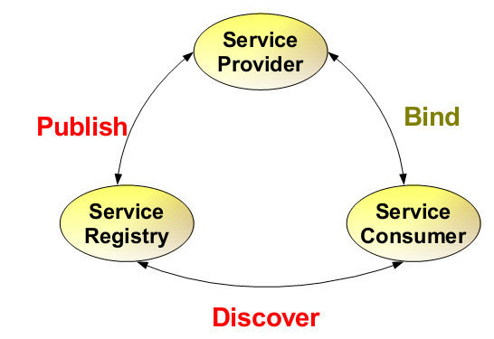
Web Service Architecture
Can you still remember what was the other name we learnt for “service consumer”?
85

Slide 86
How about service registry?
The next activity will be an open answer question. Your answer should be very short, just a few sentences.

Slide 87
Open Question
Points: 10
In our example, where
Widget, Inc. is a service provider and sells parts through its website,
customers of Widget, Inc. are service requestors and submit purchase orders and check on order status
How and when do you think would the registry be used by Widget, Inc. and their customers?
Answer

Slide 88
Web Service Architecture
88

Slide 89
Step 1:
Find Services via UDDI
Step 2:
Retrieve Service Description File:
WSDL or XML-RPC Instructions
Step 3:
Create XML-RPC or SOAP Client
Service
Registry
Discover Services
Step 4:
Invoke Remote Service
Retrieve Service
Description
Widgets Inc.
Customers
Service Description
Service
Invoke Remote
Service

Slide 90
Web Service Protocol Stack
The second way for viewing the web service architecture is to examine the emerging web service protocol stack.

Slide 91
Fill the blank(s)
Points: 0
Remark
No answer，press the setting on the right side
Click to add remark
The second way for viewing the web service architecture is to examine the emerging web service protocol stack. One of the layers in this stack, responsible for describing the public interface to a specific web service is a ___description___. The layer responsible for centralizing services into a common registry and providing easy publish/find functionality is called ___discovery___.
Please get ready to answer a question where you are asked to fill in the blanks You can input one or two words in each “blank”
Answer
Text\Image\Formula are allowed and all the content should be placed in this area

Slide 92
Web Service Protocol Stack
Searching / Publishing Web Services
Discovery UDDI
Description WSDL
Describing Web Services interface
XML Messaging XML-RPC, SOAP,XML
Transport HTTP,SMTP,FTP, BEEP
Encoding messages in XML format
Transporting XML messages between client and server
92

Slide 93
Part III: XML-RPC Essentials

Slide 94
What is a Web Service?
A Web Service is any service that:
Is available over the Internet or private (intranet) networks
Uses a standardized XML messaging system
Is not tied to any one operating system or programming language

Slide 95
Web service is not tied to any one operating system or programming language
In the next section we will explore the issue of connecting disparate systems

Slide 96
Disparate system
System that was designed to operate as a fundamentally distinct
Without exchanging data
Without interacting with other system

Slide 97
Connecting disparate systems
Modern day business applications use variety of programming platforms to develop web-based applications
Java
.Net
Angular JS
Node.js
…

Slide 98
Connecting disparate systems
Often these heterogeneous applications need some sort of communication to happen between them
Since they are built using different development languages, it becomes really difficult to ensure accurate communication between applications

Slide 99
Connecting disparate systems
Web services provide a common platform that allows multiple applications built on various programming languages to have the ability to communicate with each other

Slide 100
Connecting disparate systems - why
Important – networking, internet, building distributed systems
Always a challenge in computing

Slide 101
Connecting disparate systems - how
We want a solution in which developers can focus on the interfaces between systems, not the protocol used to connect those interfaces
What we need is to be able to carry out remote procedure call (RPC) over the internet

Slide 102
RPC – remote procedure call
In distributed computing, a remote procedure call (RPC) is when a computer program causes a procedure (subroutine) to execute in a different address space (commonly on another computer on a shared network), which is coded as if it were a normal (local) procedure call, without the programmer explicitly coding the details for the remote interaction

Slide 103
XML-RPC is one of the solutions
XML-RPC is a simple protocol for carrying out remote procedure calls (RPC) over TCP/IP
It uses two standards of the internet to create a standard way of calling remote web services and receiving a response
Hypertext Transfer Protocol (HTTP) as a transport mechanism
eXtensible Markup Language (XML) to encode it’s calls

Slide 104
XML - Extensible Markup Language
A markup language and file format for storing, transmitting, and reconstructing arbitrary data
Markup language is a text-encoding system consisting of a set of symbols inserted in a text document to control its structure, formatting, or the relationship between its parts.
It defines a set of rules for encoding documents in a format that is both human-readable and machine-readable

Slide 105
XML-RPC
XML-RPC offers a very simple, but frequently useful, set of tools for connecting disparate systems and for publishing machine-readable information

Slide 106
XML-RPC on the private network
Systems integrators and programmers building distributed systems often use XML-RPC as glue code, connecting disparate parts of a private network
By using XML-RPC, developers can focus on the interfaces between systems, not the protocol used to connect those interfaces.

Slide 107
XML-RPC on the public network
Developers building public services can use XML-RPC, defining an interface and implementing it in the language of their choice
Once that service is published to the Web, any XML-RPC capable client can connect to that service, and developers can create their own applications that use that service.

Slide 108
What is XML-RPC?
It’s a specification
It’s a set of implementations that allow software running on disparate operating systems, running in different environments to make procedure calls over the internet
Its remote procedure calling using HTTP as the transport and XML as the encoding

Slide 109
XML-RPC advantages
Simplicity - easier to integrate systems of very different types
XML-RPC's selection of data types is relatively small, but provides enough granularity that developers can express information in forms any programming language can use.

Slide 110
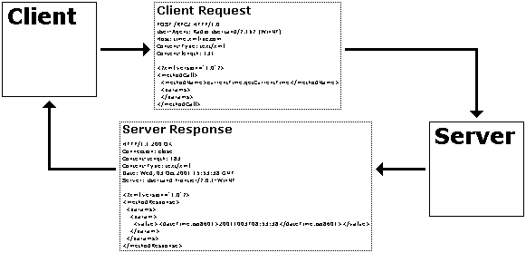
How XML-RPC works
A client performs an RPC by sending an HTTP request to a server that implements XML-RPC and receives the HTTP response
A call can have multiple parameters and one result
The protocol defines a few data types for the parameters and result

Slide 111
XML-RPC parts
XML-RPC data model
A set of types for use in passing parameters, return values, and faults (error messages)
XML-RPC request structures
An HTTP POST request containing method and parameter information
XML-RPC response structures
An HTTP response that contains return values or fault information

Slide 112
Data encoding rules
To exchange data, computers must agree on rules for encoding specific data types
Examples
two computers that process stock quotes need an agreed-upon rule for encoding float data types
two computers that process multiple stock quotes need an agreed-upon rule for encoding arrays

Slide 113
XML-RPC Data Model
The XML-RPC specification defines
6 basic data types
2 compound data types that represent combinations of types
It's enough to represent many kinds of information.

Slide 114
Basic data types in XML-RPC

Slide 115
Complex data types in XML-RPC
Arrays
represent sequential information,
Structs
represent name-value pairs, much like hashtables, associative arrays, or properties

Slide 116
Representing basic types
All of the basic types are represented by simple XML elements whose content provides the value.
Example: to define a string whose value is "Hello World!":
<string>Hello World!</string>

Slide 117
Representing arrays
Arrays are indicated by the array element, which contains a data element holding the list of values.
Like other data types, the array element must be enclosed in a value element.

Slide 118
Array

Slide 119
Multidimensional array

Slide 120
Representing structs
Structs contain unordered content, identified by name.
Names are strings, though you don't have to enclose them in string elements.
Each struct element contains a list of member elements.
Member elements each contain one name element and one value element.
The order of members is not considered important.
While the specification doesn't require names to be unique, you'll probably want to make sure they are unique for consistency.

Slide 121
Struct
Structs can also contain other structs, or even arrays.

Slide 122
Struct
Structs can also contain other structs, or even arrays.
For example, this struct contains a string, a struct, and an array

Slide 123
XML-RPC parts
XML-RPC data model
A set of types for use in passing parameters, return values, and faults (error messages)
XML-RPC request structures
An HTTP POST request containing method and parameter information
XML-RPC response structures
An HTTP response that contains return values or fault information

Slide 124
XML-RPC Request Structure
A combination of XML content and HTTP headers
The XML content uses the data typing structure to pass parameters and contains additional information identifying which procedure is being called
The HTTP headers provide a wrapper for passing the request over the Web

Slide 125
XML-RPC Request Structure
Each request contains a single XML document
root element is a methodCall element
each methodCall element contains a methodName element and a params element.
the methodName element identifies the name of the procedure to be called
the params element contains a list of parameters and their values. Each params element includes a list of param elements
param elements contain value elements

Slide 126
XML-RPC Request Structure
Each request contains a single XML document
root element is a methodCall element

Slide 127
XML-RPC Request Structure
Each request contains a single XML document
each methodCall element contains a methodName element and a params element.

Slide 128
XML-RPC Request Structure
Each request contains a single XML document
the methodName element identifies the name of the procedure to be called

Slide 129
XML-RPC Request Structure
Each request contains a single XML document
the params element contains a list of parameters and their values. Each params element includes a list of param elements

Slide 130
XML-RPC Request Structure
Each request contains a single XML document
param elements contain value elements

Slide 131
XML-RPC Request Structure

Slide 133
XML-RPC Request Structure
The HTTP headers for these requests will reflect the senders and the content. The basic template looks like:
The information in italics may change from client to client or from request to request.

Slide 134
XML-RPC Request Structure
For example, if the circleArea method were available from an XML-RPC server listening at /xmlrpc, the request might look like:

Slide 136
XML-RPC Response Structure
If the response is successful - the procedure was found, executed correctly, and returned results - then the XML-RPC response will look much like a request, except that the methodCall element is replaced by a methodResponse element and there is no methodName element:

Slide 137
XML-RPC Response Structure
An XML-RPC response can only contain one parameter, despite the use of the enclosing params element. That parameter, may, of course, be an array or a struct, so it is possible to return multiple values.
Even if your method isn't designed to return a value (void methods in C, C++, or Java, for instance) you still have to return something. A "success value" – for example a boolean set to true (1) - is a typical approach to getting around this limitation.

Slide 138
Fault response
If there was a problem in processing the XML-RPC request, the methodResponse element will contain a fault element instead of a params element. The fault element, like the params element, has only a single value. Instead of containing a response to the request, however, that value indicates that something went wrong.

Slide 139
Developing with XML-RPC
Using XML-RPC in applications generally means adding an XML-RPC library and making some of the function calls through that library.
Creating functions that will work smoothly with XML-RPC requires writing code that uses only the basic types XML-RPC supports.
Adding XML-RPC support may require writing some wrapper code that connects the code with the library, but this generally isn't very difficult.

Slide 140
Criticism of XML-RPC
Critics argue that RPC calls can be made with plain XML instead
Both XML-RPC and XML require an application level data model (such as which filed names are defined in the XML schema or the parameter names in XML-RPC)
XML-RPC uses about 4 times the number of bytes compared to plain XML to encode the same objects
Does XML-RPC add any value?

Slide 141
Open Question
Points: 10
Does XML-RPC add any value?
Answer

Slide 142
Benefits of XML-RPC
Well defined protocol
Grater support from libraries
Many available implementations
You don’t have to write as much code
...

Slide 143
XML-RPC
XML-RPC offers a very simple, but frequently useful, set of tools for connecting disparate systems and for publishing machine-readable information.

Slide 144
Open Question
Points: 10
XML-RPC offers a set of tools for connecting disparate systems and for publishing machine readable information. Can the same be achieved by using plain XML?
Answer

Slide 145
Connecting disparate systems – how (1)
XML – data format, not a protocol
Flexibility
Cross-platform usability
XML over HTTP POST request
Sender assembles XML document and sends it much like HTML from data
Recipient processes the XML and sends back the response, also in XML
Developers need to create custom vocabularies for these transactions

Slide 146
Connecting disparate systems – how (2)
Use standardized vocabularies
XML-RPC
A very simple protocol, uses XML messages travelling on HTTP to represent client-server remote procedure call (RPC)
XML messages identify methods, parameters, and the results for calling the methods
XML documents use simple but effective set of data types to pass information between computers
SOAP
Details in Module 2

Slide 147
Connecting disparate systems – how (3)
REST
HTTP-based alternative
BEEP
Uses XML to build protocols on TCP sockets
Supports HTTP-style message-and-reply
SOAP messages can be transmitted over BEEP

Slide 148
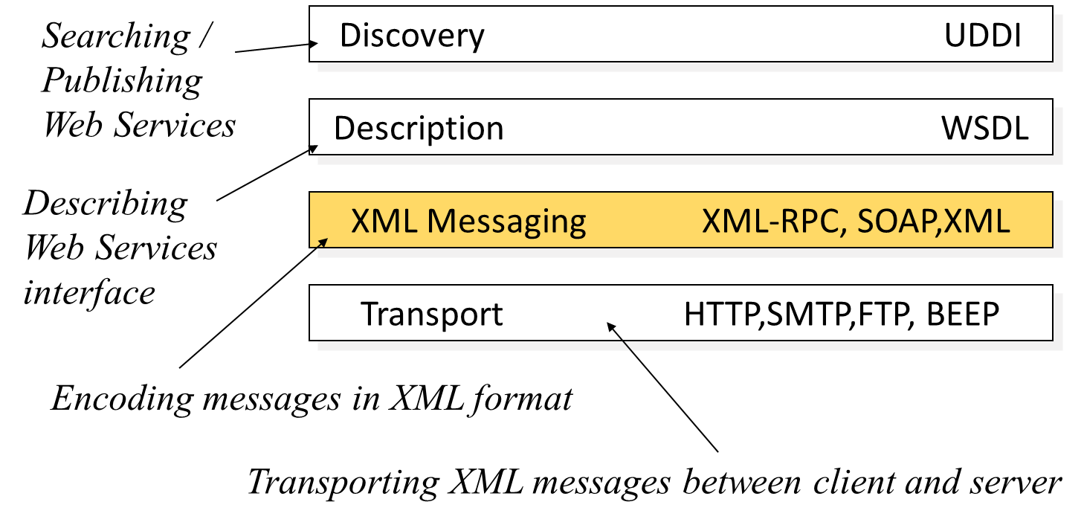
Open Question
Points: 10
What is the relationship between XML, XML-RPC, and SOAP?
Open Question is only supported on Version 2.0 or newer.
Answer

Slide 149
Module 1 Summary
Concept of “service oriented” and the background of service computing
Web Services architecture
Web service actors and their roles
Web service protocol stack
Basics of XML-RPC technology

